Slide 1
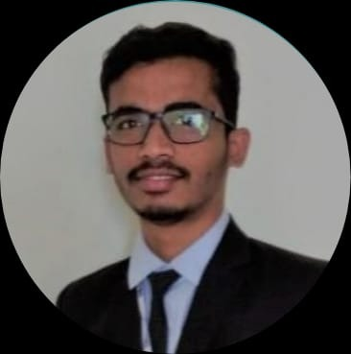


Sanket Londhe
Bachelor of Engineering
2018 - 2022
Skills Java 8 /J2EE
Spring Boot
Spring MVC
JPA CRUD
Bootstrap
Full Stack
ReactJS
Spring Boot
MySQL
MongoDB
Database
SQL database – MySQL
No SQL database – MongoDB
Web Technologies
HTML5
CSS3
JavaScript
Add-ons
GitHub
Maven
Postman
Swagger
Additional Details
Leadership
Excellent Communication Skills
Team management
Analyst/Software Engineer
Airoli, Mumbai
sanket-hemant.londhe@capgemini.com
+91 9359241586
A4
Software Engineer who is Strong in design and integration with intuitive problem-solving skills. Passionate about implementing and launching new projects.
Ready to learn new technologies and implement them to further improve my knowledge.
Eager to work in a team of dedicated people and serve a key role in the enhancement and development of the project.
Has working knowledge on ReactJS(Hooks, redux)and Java Microservice Development using Spring framework on an intermediate level.
Worked with different technologies like Jenkins (CI/CD), React JS, Docker to enhance the application for a market level standard
Pharmacy Management System
Completed end to end case study of Pharmacy Management System Application along with JWT authentication, Swagger and payment testing and applied different technologies to enhance the application. In front end, I used JavaScript with React as framework, Bootstrap used for user interface with HTML and CSS.
Completed Course on Full Stack Java Developer
( 3RI Institute Pune)
Duration- October to January.
Check out me on GitHub & LinkedIn

